Slide 1
Lifecourse institutional pathways for people experiencing disadvantage and disability
Presenter : Eileen Baldry
Research Team: Eileen Baldry, Leanne Dowse, Melissa Clarence, Phillip Snoyman, Devon Indig, Ruth McCausland, Han Xu, Peta MacGillivray, Julian Trofimovs
SA Exceptional needs unit 21.11.13

Slide 2
Presentation Outline
Getting good data: the MHDCD project
Pathways
Costs
Discussion
Conclusions
2

Slide 3
Benefit of linked data: Human, Health & CJ
Accurate event records: does not rely on self report / memory
But provides very rich individual as well as system information
Reveals extent and depth of social determinants
Shows the complex interactions amongst services & lifecourse pathways through agencies
Enables far more accurate costings

Slide 4
The study
ARC Linkage study 2007-2010
CIs: Eileen Baldry, Leanne Dowse, Ian Webster
PIs: Tony Butler, Simon Eyland, Jim Simpson
Partner Organisations: Corrective Services NSW, Justice Health, NSW Police, Housing NSW, NSW Council for Intellectual Disability, Juvenile Justice NSW
Continuing with ARC Linkage Indigenous Australians with mental health disorders and cognitive disability in the CJS 2011-2013

Slide 5
The Study approach
Method: Innovative data linkage and merging
Cohort: 2001 Inmate Health Survey & DCS Statewide Disability database
Add Data drawn from:
The Centre for Health Research in CJS Health NSW (+data from 2009 survey)
NSW Department of Corrective Services
BOCSAR
NSW Police
Juvenile Justice
Housing NSW
ADHC
Legal Aid NSW
NSW Health (mortality, pharma., admissions)
Community Services – out of home care
Negotiating Public Guardian & Financial Manager

Slide 6
SQL server, relational dataset
Cohort
ID
2,731
DCS
Police
Court
Housing
Justice Health
Child Services
Health
Disability
Legal Aid
Juvenile Justice

Slide 7
Cohort - Summary
Full Cohort N=2,731
ID/BID N = 1,400
MH = ~ 65%
Complex Needs = ~ 70%
Women = 11%
Indigenous Australians = 25%
~40% had been Juvenile Justice clients

Slide 8
Pathways

Slide 9
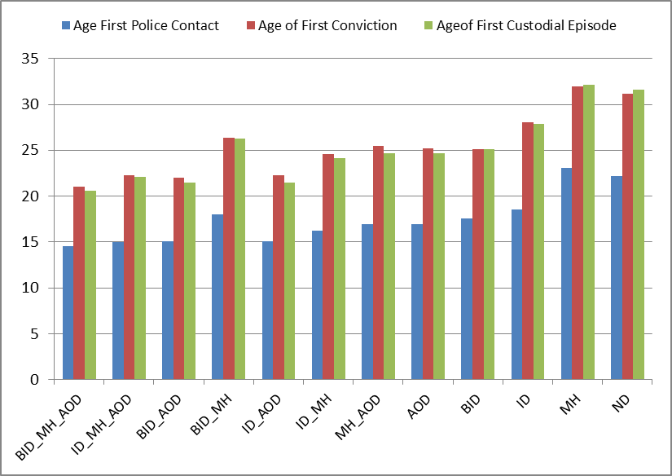
Analyses using diagnoses eg

Slide 10
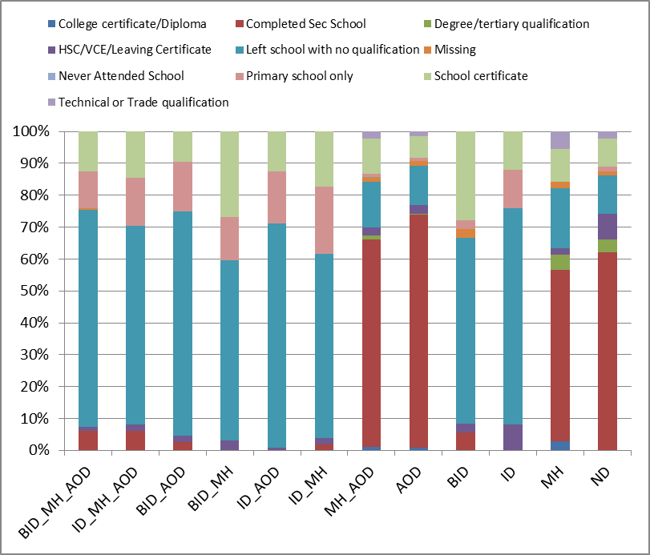

Slide 11
MHDCD Study: Education
Diagnosed groups even lower levels than general prisoner pop.
Those with complex needs have higher rates of expulsion
Those with some form of CD have the worst levels of education.
Complex groups: over 80% have no formal qualification with majority leaving school without completing Yr10

Slide 12
School Expulsion: MHDCD cohort compared with Inmate Health Survey Sample
Higher proportion of those in the MHDCD cohort both males (44%v 39%) and females (35%v29%) had ever been expelled from school. Much larger % reported being suspended.

Slide 13
Out of home care
12% of the cohort had been in OHC
60% of the OHC group have complex needs
80% of this group has cognitive impairment
Women in the MHDCD cohort had a higher rate of their own parent having been in OHC than all others
Earlier police contact
Twice as many police contacts
Twice as many custodial episodes
Three times as likely to have been incarcerated as juvenile

Slide 14
Disability service
Of those in the ID range (680) 26% ADHC clients
Of those BID range (783) 5% ADHC clients.
Very low rate (15%) of CD in cohort with ADHC services
Only 10/709 JJ CD group
were ADHC clients
79% of ADHC clients imprisoned prior to becoming a client

Slide 15
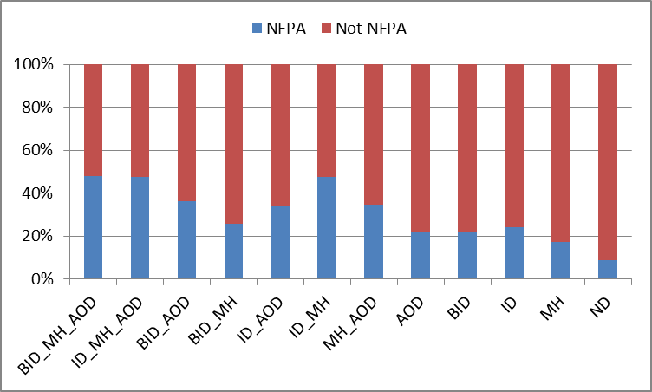

Slide 16
Housing Assistance
Significant numbers of the complex groups experienced homelessness and unstable housing as young people and as adults
Significant numbers had parent(s) in public housing
Significant numbers accommodated in refuges and other crisis accommodation.

Slide 17
Police Contacts
People with Complex Cognitive Disability had significantly more police contacts over their lives, starting young, and significantly higher rates of police contacts per year

Slide 18
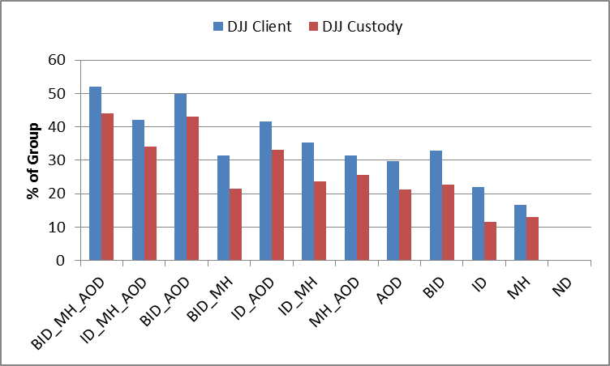
Contact with Juvenile Justice
Sig. higher rate of being a JJ client for compounding CD groups - between 40% to 60%; Aboriginal young people sig over-represented
But ~ 15% for those with MH only and none for no diagnosis

Slide 19
JJ Custodial episodes & LOS
CD complex significantly more JJ custodial episodes than MH & no diagnosis. All groups significantly shorter av days (largely remand) than no diagnosis groups

Slide 20
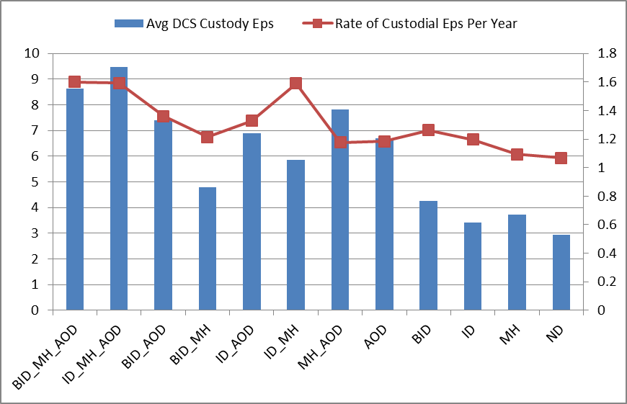
All custody
Those with compounding disabilities have shorter duration each time in custody, than BID, MH or no diagnosis but similar av. number of days per year in custody (ie more short stays).

Slide 21
Pathway Indicators
Individuals with CI complex needs who end up in adult prison:
significantly higher rates of and earlier contact with police
more likely to be Indigenous Australian
significantly worse education experience & attainment
significantly more likely to have been in OHC
significantly more likely to experience abuse and be a victim
lower level of disability & health services than peers but likely identified by school & police as a child with problems
more likely in public housing as a child and higher housing support but also higher failed tenancies as an adult
significantly higher chronic health
significantly higher rates of JJ contact
significantly higher number of offences, convictions, imprisonments (particularly remand) from an earlier age
significantly shorter and more frequent prison episodes
significantly higher continuing lifelong CJS episodes
than single diagnosis and non-diagnosis groups

Slide 22
Importance of place
People with CI complex needs come from and move around amongst a small number of disadvantaged suburbs / towns; those with complex needs have more addresses (recorded by agencies) than those without.
Liminal, marginal, community-criminal justice space

Slide 23
CI & pathways into the CJS Multi-factorial and multi-stage
Socio-economic / poverty / disadvantage / discrimination / geography
Individual
Lack of family capacity & intergenerational aspects
Lack of appropriate identification, assessment and support
Negative synergistic interactions between agencies and services creating complex needs
Consider along with institutional pathways costings

Slide 24
Pathways: iterative, looping, cycling, compounding
Poverty/disadvantage
Poor School Education
Lack Disability services
Poor physical & Mental Health
Legal Aid
Police
Housing/homelessness
Courts
Prison
Post-release
Breaching
Reincarceration

Slide 26
Costs/cost benefits: Casey
Aboriginal woman (now 23): disadvantaged family & Western NSW town, ID, MH, no disability service, OOHC, chronic health, abuse, AOD, disengaged from school by 13, managed by police, from age 11, JJ, psych units, adult prison, finally intensive disability service.
Events eg:
CS – 26 notifications, 1169 OOHC days = $194,600
Police – 356 incidents, 81 custody days = $622,100
DJJ – 419 custody days = $478,000
All Health – 72 hosp adm, ~500 days = $360,000
Adult Disability service = $3.5 m
Total agency cost so far - $5.5m

Slide 27
So …
elements and circumstances interact simultaneously and across time. The interactions have a compounding effect (like interest on money in a bank account) in that the effect is not just the sum of the individual parts but each aspect adds to and increases the potency of each of the other effects.

Slide 28
Individualisation
The compounding disabilities and disadvantages are attributed primarily to the individual
Problems individualized (she or he is responsible for the complexity); social & structural factors that created and maintained the need or dysfunction written out of the story
From at risk to being a risk

Slide 29
Creation of complex needs
Lack of appropriate support and services
the use of control agencies (eg police as ‘care managers’)
application of ‘risk’ management for individuals experiencing multiple disadvantages & mental and/ or cognitive impairment
compounds these multiple difficult life issues creating complex needs

Slide 30
New Conceptualisation of Disability in CJS
Highly disadvantaged places early in life & funneled into a liminal marginalised community/criminal justice space
Not falling through the cracks, rather, as young people on the conveyor belt / given a ticket on the CJS train. Systematic and patterned.

