Slide 1
Grants SA Community Sheds Information Session May 2025
Notes:
Cover slide: option 1

Slide 2
Acknowledgement
We would like to acknowledge this land that we meet on today is the traditional lands for the Kaurna people and we respect their spiritual relationship with their country.
We also acknowledge the Kaurna people as the custodians of the greater Adelaide region and that their cultural and heritage beliefs are still as important to the living Kaurna people today.
Notes:
Cover slide: option 2

Slide 3
About Grants SA
Grants SA offers funding to eligible organisations for projects with outcomes of improved community participation, social and emotional wellbeing, and quality of life for people living and working in South Australia.
Our funding aligns to the state governments commitments to Closing the Gap Priority Reform Two: Building the Aboriginal Community-Controlled Sector to deliver services.
Our funding is derived from the Charitable and Social Welfare fund.

Slide 4
Priority Focus Groups
Funding is prioritised for projects that support people and/or communities experiencing socioeconomic disadvantage and other vulnerabilities and who may face additional barriers to accessing services such as:
Aboriginal peoples.
People from new and emerging culturally and linguistically diverse (CALD) communities.
People with disability, with a focus on those not currently supported through the NDIS.
LGBTIQA+ community.
People who are financially disadvantaged (for example unemployed, in receipt of government support payments, health care card).
People residing in communities identified as places where persistent and/or relative location-based disadvantage exists (including rural/remote). Areas of disadvantage as identified by the Socio- Economic Indexes for Areas

Slide 5
Community Sheds – Key Dates
The Round opened 30 April 2025 and closes 3 pm, 19 June 2025.
Notification of the outcome will be after 25 August 2025.
Grant agreement period will start after 1 October 2025

Slide 6
The intent of the Community Shed funding round
The Community Shed funding round aims to increase participation, capacity, and sustainability of community sheds throughout South Australia. This funding aims to support initiatives that will achieve positive outcomes for community sheds in the following areas:
Wellbeing, Social isolation and loneliness, improved sense of community connection
Increase participation and diversity specifically from groups likely to experience social isolation and/ or discrimination including people with disability or aged related disability, and people experiencing poor health or mental health challenges.
Skill sharing and mentoring
Support the sustainability of current operations.
Volunteering

Slide 7
Eligibility
Applicants must meet the definition of a Community Shed.
What is a Community Shed?
A Community Shed (including Men’s and Women’s Sheds) is any community-based organisation, where:
The primary objective is to advance the well-being, positive mental health, and social connection of its members.
The primary activity is the provision of a safe, friendly, and inclusive environment where people can gather and/or work on meaningful projects at their own pace, in their own time and encourage participation and share experiences and expertise in a supportive environment.

Slide 8
Eligibility for a grant
A Community Shed can be a purpose-built facility, a multipurpose community building, or shared space used on a regular basis for the purpose of shed like activities and may:
Make a variety of products including toys, household, or garden furniture, Indigenous arts and crafts, wood turned articles or textiles
Undertake activities that may include gardening, wood turning, metalwork, repairs or restoration, bicycle and small engine maintenance, cooking, or nutrition demonstrations.
Undertake community projects if desired.
Participate in training programs such as first aid and computers/IT.

Slide 9
Eligible Organisations
Organisations that do not meet the definition of a Community Shed are not eligible in this round. Organisations must demonstrate their eligibility within the application process. This could include membership of the Australian Men’s Shed Association, your Shed constitution or other supporting evidence including a Charter of Rules of your association or a calendar of events or activities.
To align with the Charitable and Social Welfare Fund, Grants SA awards funds to the following eligible organisation types:
Aboriginal Community-Controlled Organisations (ACCO), or
Not-for-profit organisations
You are not eligible if you are an individual, sole trader, a for-profit organisation, a private company or a trust (except fixed Trusts)

Slide 10
Sponsoring and Ineligible Applicants
Organisations that are not incorporated and/or do not have an ABN, can apply if they meet all other eligibility criteria and are able to secure an eligible organisation to act as their sponsor (auspice) for the project.
Information on sponsorship arrangements can be found on page 5 of the Guidelines.
Grant funds can only go to community-based or community-controlled not-for-profit organisations that are either incorporated or can show evidence of a comparable legal status. This is to ensure funding is provided to organisations that are the intended recipients of the Charitable and Social Welfare Fund.
Notes:
If you have a specific question about your Organisations eligibility, I suggest you email or call Grants SA directly to discuss.

Slide 11
Community Sheds Funding Opportunities (1)
This round offers single grants of up to $30,000 to support the following
Capital works for existing sheds
Example: Alterations, extensions, or improvements e.g., electrical, or plumbing upgrades, kitchen or bathroom upgrades for accessibility, health and hygiene, internal walling, or the enclosing of outdoor spaces to create additional work or storage spaces and sustainability measures including solar systems and batteries, rainwater tanks and pumps.
Tools, Equipment and Occupational Health and Safety Measures
Example: Lathes, welding equipment, power, hand or gardening tools, dust extraction systems, manual handling equipment, 3D Technologies including 3D printers, CNC routers and laser cutters, storage, safety equipment, signage, first aid kits excluding defibrillators.
Please note that this fund will not support the purchase of defibrillators – alternative funding sources include AMSA and Preventative Health SA.

Slide 12
Community Sheds Funding Opportunities (2)
Resources for communal spaces including kitchens to support participation
Example: Stoves, cooking equipment, fridges, tables and chairs, microwaves, digital equipment for training and governance, filing cabinets.
Community Food Gardens
Example: Raised beds, soils, storage, tools, irrigation, fruit trees, vegetable seedlings
Support for Volunteer recruitment and development
Example: Volunteer training including digital skills, governance training, finance, Mental Health First Aid, electrical test and tagging, hosting knowledge sharing events or demonstrations.
Mentoring and Knowledge Sharing
Example: Mentoring programs including intergenerational mentoring, linking with youth groups or schools, shed to shed mentoring, hosting knowledge sharing events or demonstrations.

Slide 13
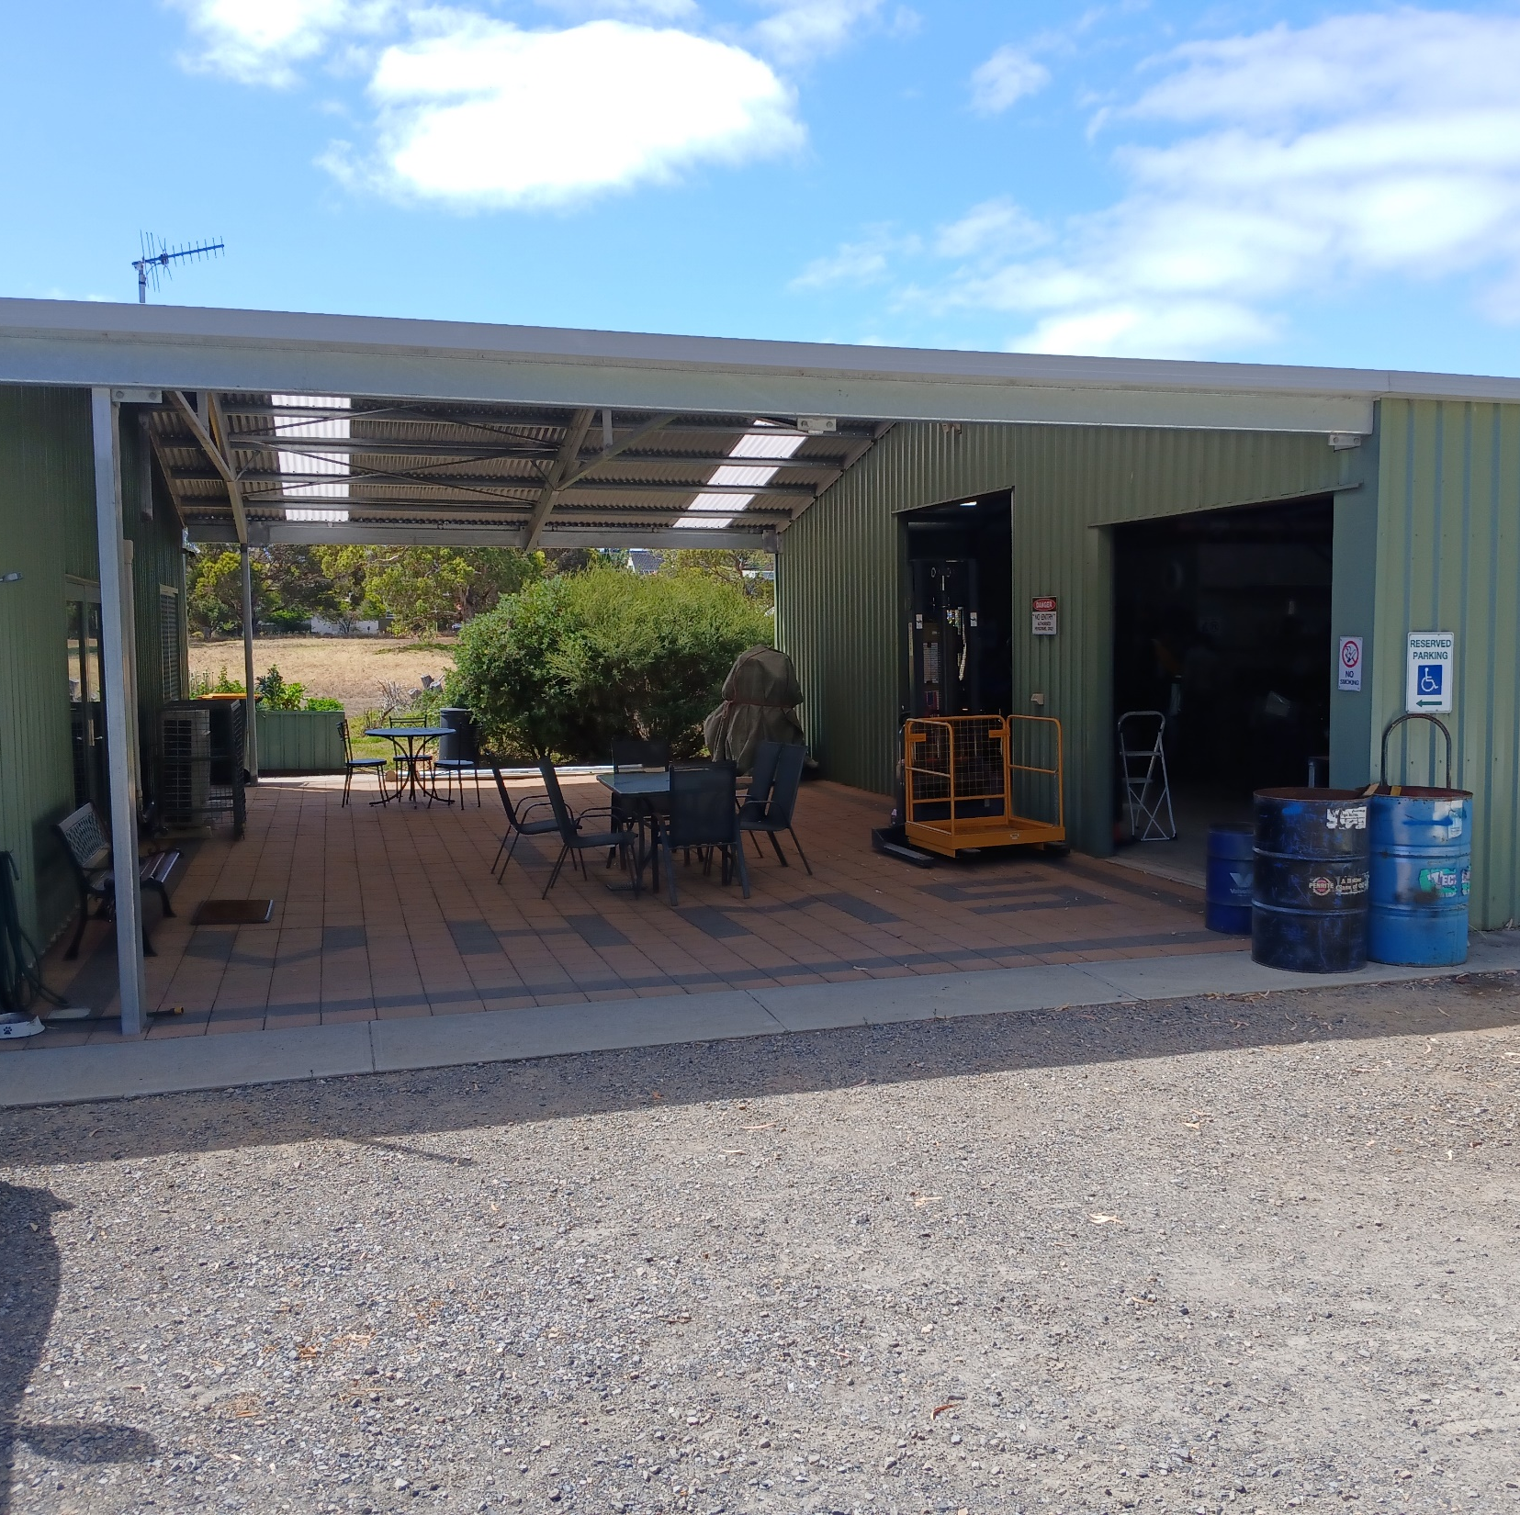
Uniting Church in Victor Harbor
The 162 Shedders and other community groups who are welcomed to the shed were delighted to receive $9,555 to extend the cover to link the two sheds.
This created an entertainment area for BBQ’s, and a usable space for larger projects such as the manufacture of Bus Shelters.

Slide 14
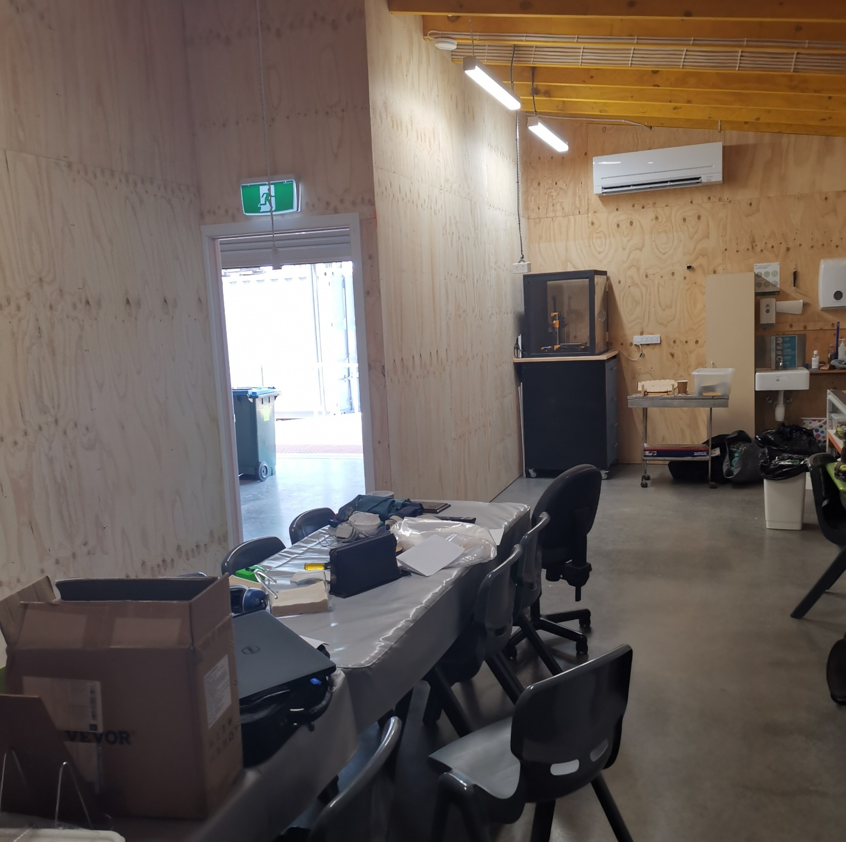
Regency Community Men’s Shed
This Shed received $19,476 to create a quiet, dust free area where shedders can socialise and carry out activities that are not woodwork-related such as painting, 3D printer design, model construction.

Slide 15
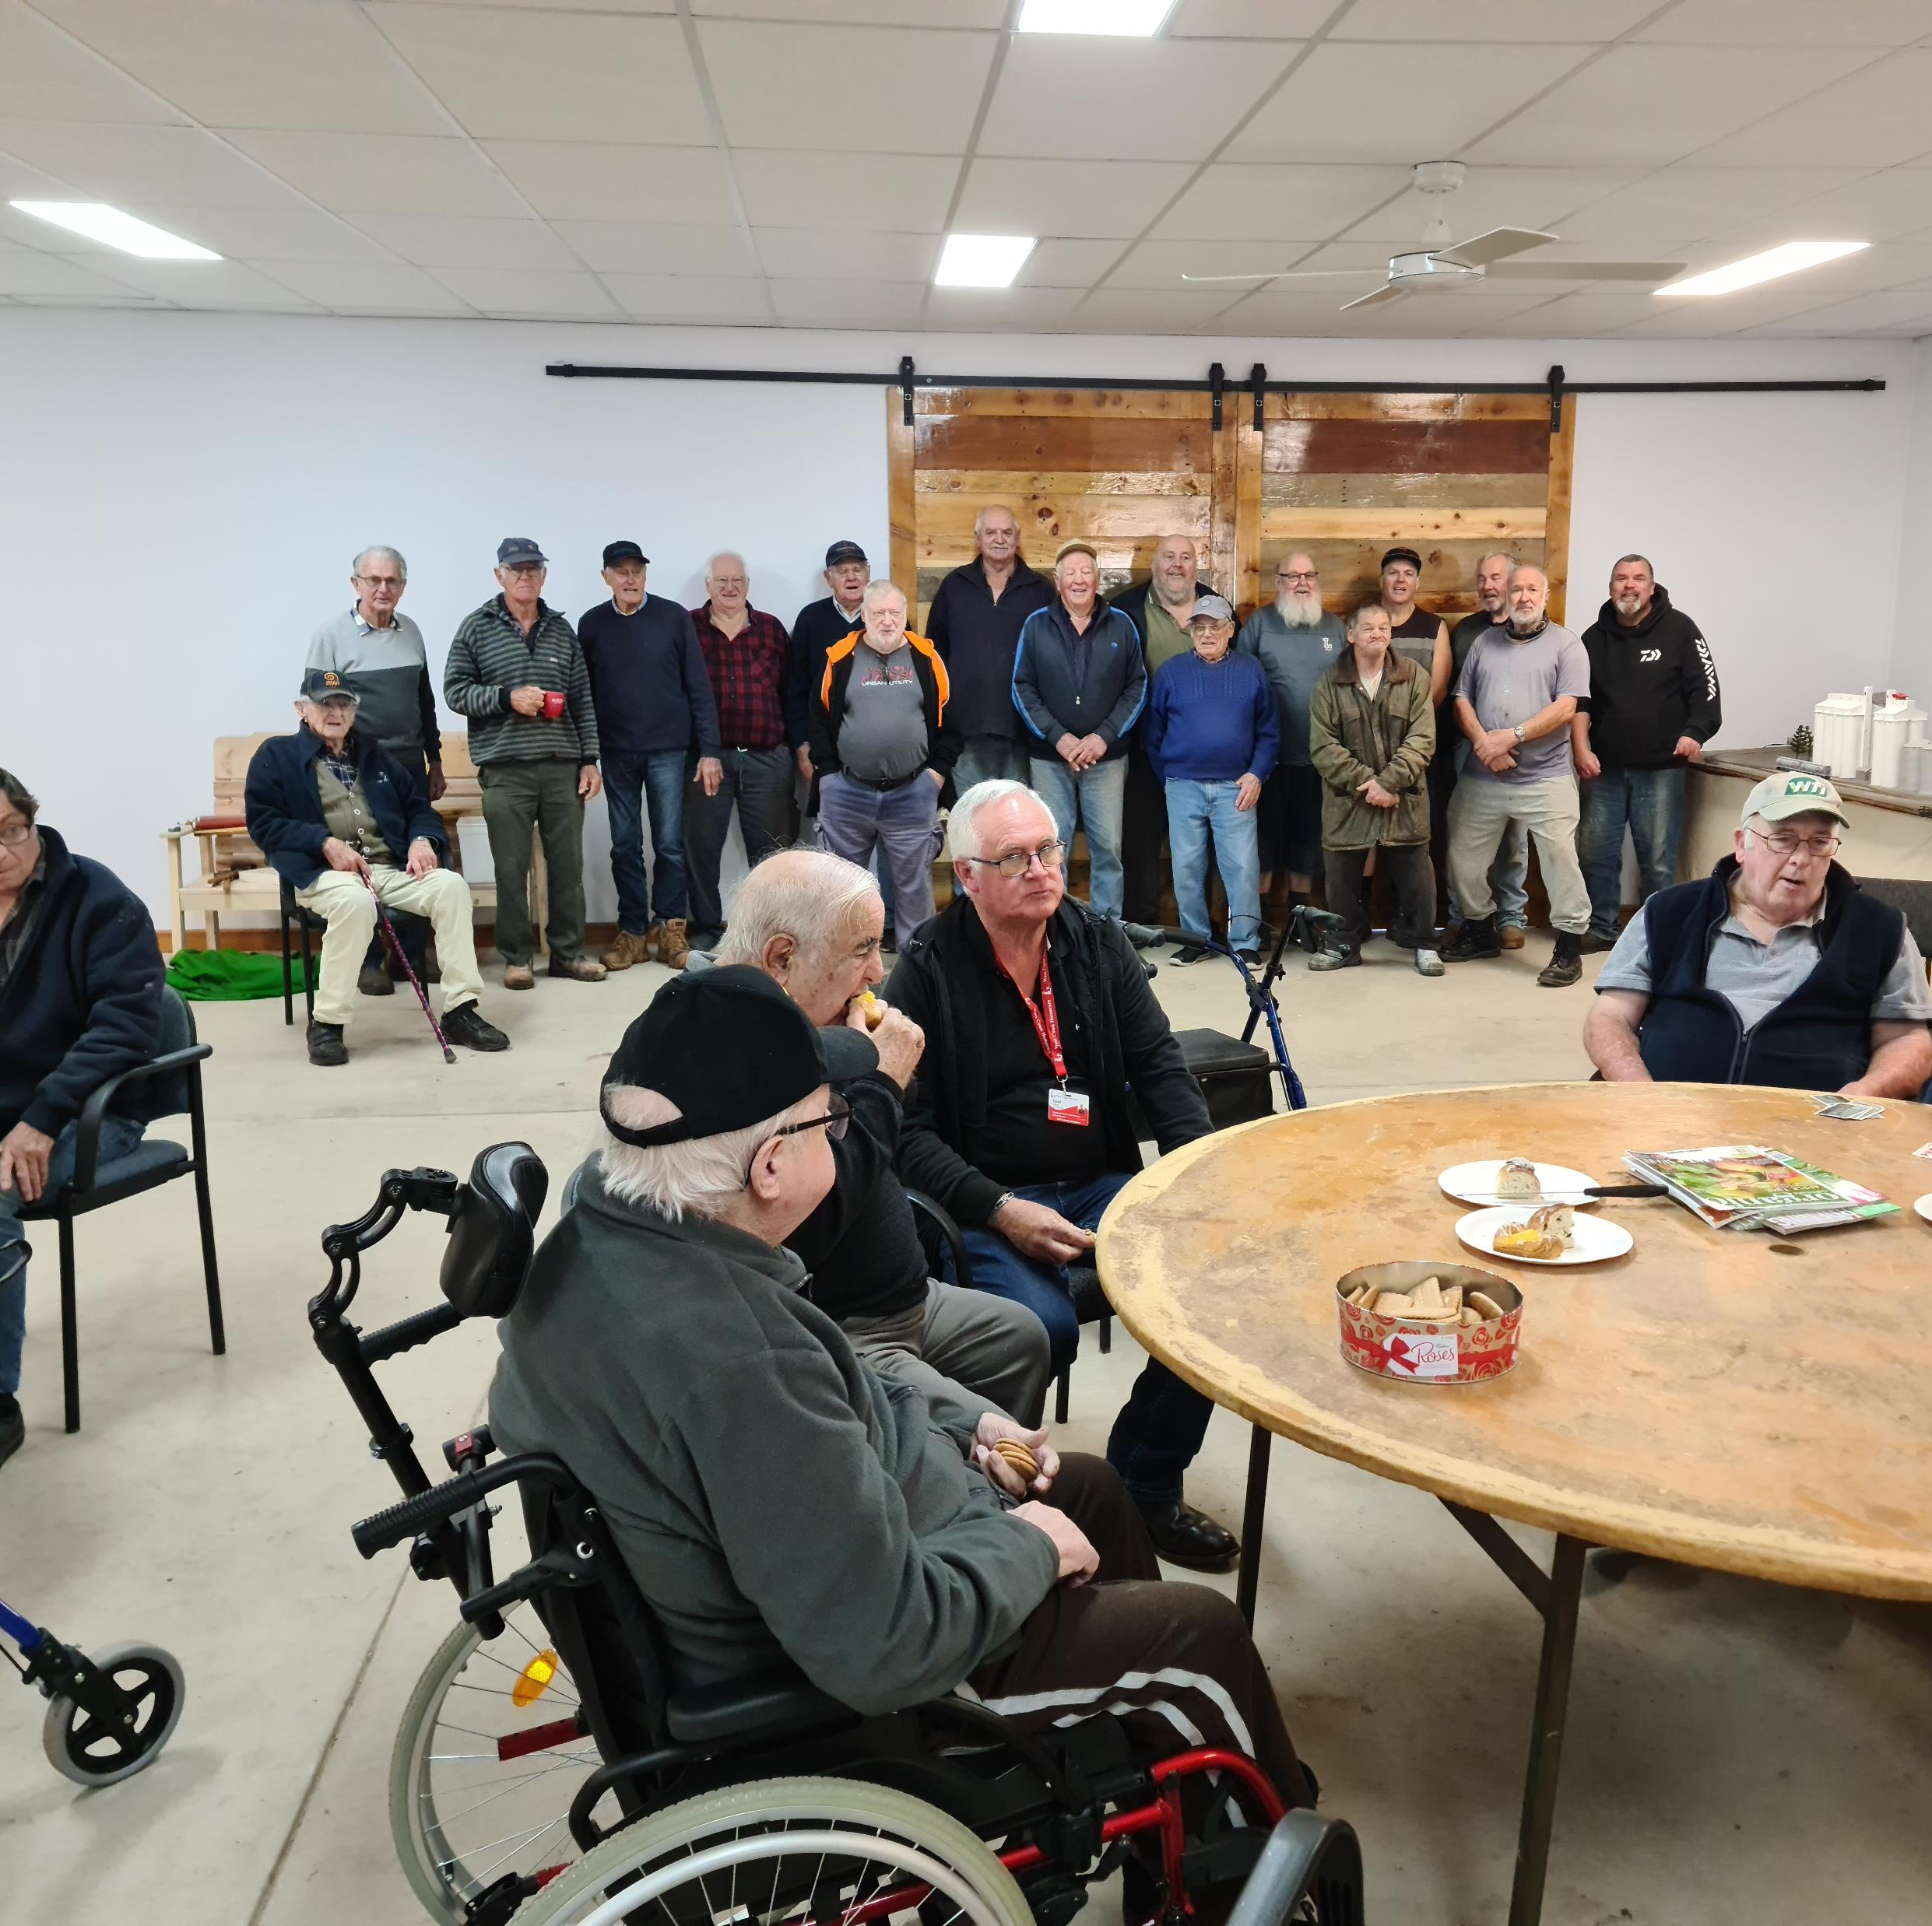
Cleve & Districts Men’s Shed
The shed was a metal clad structure subject to temperature extremes. With $21,406, in funding the building was transformed into a venue which could be used year-round. Capital works included a suspended ceiling with new energy efficient lighting, a partition wall to separate the meeting area from the metal work precinct, clad walls with insulation and added new windows and access doors.

Slide 16
Eudunda Community Shed and Hub
With $25,000 in funding, Eudunda Community Shed and Hub purchased a transportable building to provide a safe and comfortable environment for all community members wishing to attend our facility. Previously, Shed activities were limited by the lack of space.

Slide 17
Ineligible Items (listed on Page 7 of the Guidelines)
Grants SA funding cannot be used for the following items.
If these items are included in the budget for your application, they will be removed from your funding request:
Core business costs such as operational staff wages, rent, insurances, utilities, internet, websites, phones, phone systems and video conferencing, purchase or lease of buildings, land, vehicles, or lease of IT equipment. Payment of volunteers, boards or committee members (including honorariums).
Delivery of services, advocacy, outreach and case management services
Marketing and administration costs above 10% of the total project value.
Retrospective funding for items, services, or resources already paid for or purchased.
Items to be purchased and distributed to individuals as prizes, awards, gifts, trophies, sponsorships, fundraising, donations, reimbursements, uniforms, and costumes.
Emergency and food relief (such as food hampers, food vouchers, pre-paid store cards, individual debt, or bill payments).
Defibrillators (please see General Resources section pg. 12 for potential funding of Defibrillators)
Grants writer, auspice, audit fees, research projects, feasibility studies, Council and/or building approvals.
Purely sport and/or recreational activities.
Projects that focus on Religious, political, or animal welfare outcomes.

Slide 18
Application Process
How to apply
Submit your application through SmartyGrants, the link is on our website.
Don’t forget to press save as you progress through answering the questions.
Upload required documentation, there are mandatory fields in the application which prevent you from submitting the application without answering all the key questions.
Organisations will be funded for a maximum of 2 grants per financial year, however, only one application per grant round can be successful.

Slide 19
Application Form – Project Details
Project Title
Provide a brief description of the project – Key activities, actions or services.
How will your project create strong and inclusive communities, and/or advance social and emotional wellbeing in your community? ( This is the funding focus of this round)
What is the community need for your project will address and how was this need identified?
Explain why this project is important for your community shed?
How will you measure the impact or benefit of this project?

Slide 20
Application Form – Required Documentation
Quotes for all items requested in Budget
Capital works applications
Will be required to submit a project plan outlining timeframes, resources, capacity of personnel or contractors involved and a schedule of activities. A project plan template is available for download from a link within the online application form.
For infrastructure project building owner consent, lease agreement (3-year lease minimum) and council approval may be required.

Slide 21
Budgets
Grant expenditure - Items you wish to purchase with the grant:
Group each item you need funding for in separate rows, using the + and - buttons to add or remove rows.
If the quote includes GST, calculate the GST exclusive amount by dividing the total by 1.1 and the GST by multiplying the exclusive amount by 0.1.
This budget will form the basis of the funding contract if successful.
GST is added into your awarded grant when paid.

Slide 22
Application Form – Budget (continued)
Total project income and expenditure
Financial and non-financial contributions (in-kind support) such as volunteer time, donated goods, facility hire (income)
Total contribution $2,000.
This number is auto-calculated
Financial Contribution (including source) | Amount $ | Status
Our Organisation | $1,000 | Confirmed
XYZ Grant | $1,000 | Requested

Slide 23
Assessment Criteria
Criterion | Percentage | Comments
Linkage to the published Guidelines | 20 | How well does the application align with the funding focus? Does this proposal support Shed or Shed like activities? Does the application identify strategies to support inclusion of any of the priority groups?
Community need | 30 | What community shed need is being addressed? Is there evidence of community engagement to identify need, including aligning with priority groups? How well will this project address the community shed need?
Direct Community Impact | 30 | Evidence that the project will connect and/or reconnect with shed community to increase shed participation, capacity, and /or sustainability. And /Or Evidence that this project provides new or expanded opportunities for skill development or sharing, mentorship or intergenerational activities and learning.
Value for Money | 20 | The value for money given the number of people who will directly benefit considering the SEIFA and regional or remote location of the applicant. Applications must contain reasonable and realistic costs as outlined in attached quotes, application budget and project timeline.

Slide 24
Assessment Process
How applications are assessed:
Stage One:
Applications are screened by Grants SA staff for Organisation and Project eligibility.
Stage Two:
Eligible applications are assessed by an Assessment panel that comprises of external community members.
Applications are assessed against the criteria in the assessment matrix refer page 9 of the Guidelines.
The panel makes recommendations to the delegate for funding.

Slide 25
Notification of Applicants
All applicants will be notified in writing via email
Ineligible applicants will be notified with the reason their application was ineligible.
Unsuccessful applicants are encouraged to contact Grants SA for feedback on their application.

Slide 26
Successful Applicants
Will receive written notification via an email to your nominated First Office Bearer from the Minister for Human Services.
A grant funding agreement will be sent after the notification. The agreement will be signed electronically using DocuSign.
Read the agreement prior to authorising. Grants are not paid until the agreements are electronically signed by your two authorised delegates.

Slide 27
Your Grant Agreement
The Funding Agreement outlines:
Project, amount and items to be funded
Contracting period: 18 months
Awarded monies cannot be spent outside of the contract dates
Requirement to have public liability insurance
Reports required during and at the completion of the project.
Other documents to be completed along with your Funding Agreement
Recipient Created Tax Invoice (RCTI) Agreement
EFT Form – including bank account details

Slide 28
Searching for other funding opportunities:
Department of Human Services https://dhs.sa.gov.au/how-we-help/grants
Community Grants Hub (Aust Govt) www.communitygrants.gov.au
GrantGuru https://grantguru.com/au/register
The Funding Centre www.fundingcentre.com.au
Multicultural Affairs https://www.dpc.sa.gov.au/responsibilities/multicultural-affairs/grants
National Shed Development Program: https://mensshed.org/for-mens-sheds/grants-funding/

Slide 29
Any further questions?
At any stage of the process please don’t hesitate in contacting us:
Grants SA Team
Phone: 1300 650 985
Email: grantssa@sa.gov.au
Website: www.dhs.sa.gov.au/grantsSA

Slide 30
Thank you

